Slide 1
AVL Trees
Algorithms & Data Structures
ITCS 6114/8114
Dr. Dewan Tanvir Ahmed
Department of Computer Science
University of North Carolina at Charlotte

Slide 2
AVL Trees
6
v
3
8
z
4

Slide 3
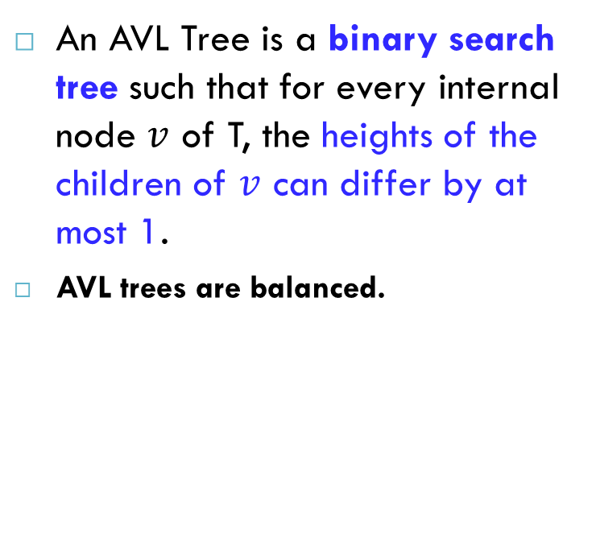
AVL Tree Definition
An AVL Tree is a binary search tree such that for every internal node $v$ of T, the heights of the children of $v$ can differ by at most 1.
AVL trees are balanced.
An example of an AVL tree where the heights are shown next to the nodes:

Slide 4
Balanced and unbalanced BST
4
1
2
5
2
13
1
3
14
Is this “balanced”?
25
4
26
2
6
27
1
3
5
7

Slide 5
Perfect Balance
Make a complete tree after every operation (e.g. insertion)
tree is full except possibly at the highest depth (in the lower right)
This is expensive
For example, insert 3 in the tree on the left and then rebuild as a complete tree
Insert 3 & complete tree
6
5
4
9
3
8
1
5
8
1
4
6
9

Slide 6
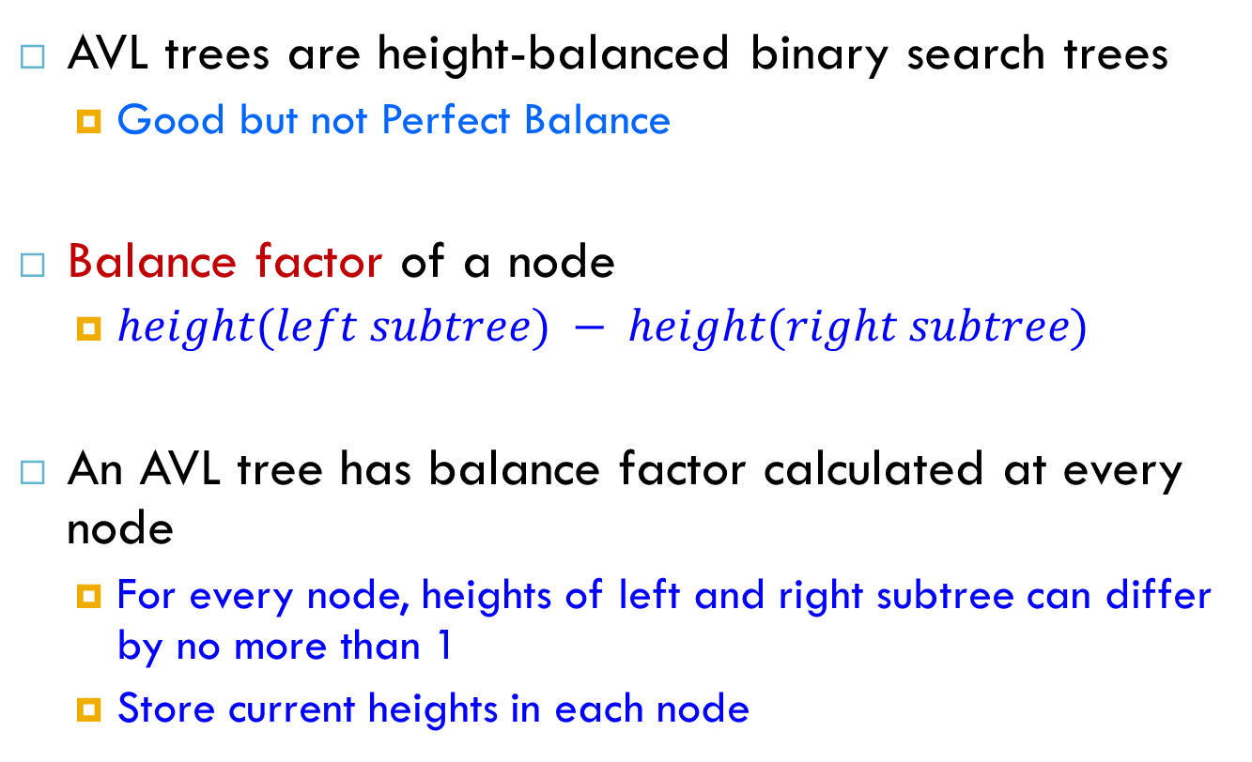
AVL – Some points
AVL trees are height-balanced binary search trees
Good but not Perfect Balance
Balance factor of a node
$height(left subtree) − height(right subtree)$
An AVL tree has balance factor calculated at every node
For every node, heights of left and right subtree can differ by no more than 1
Store current heights in each node

Slide 7
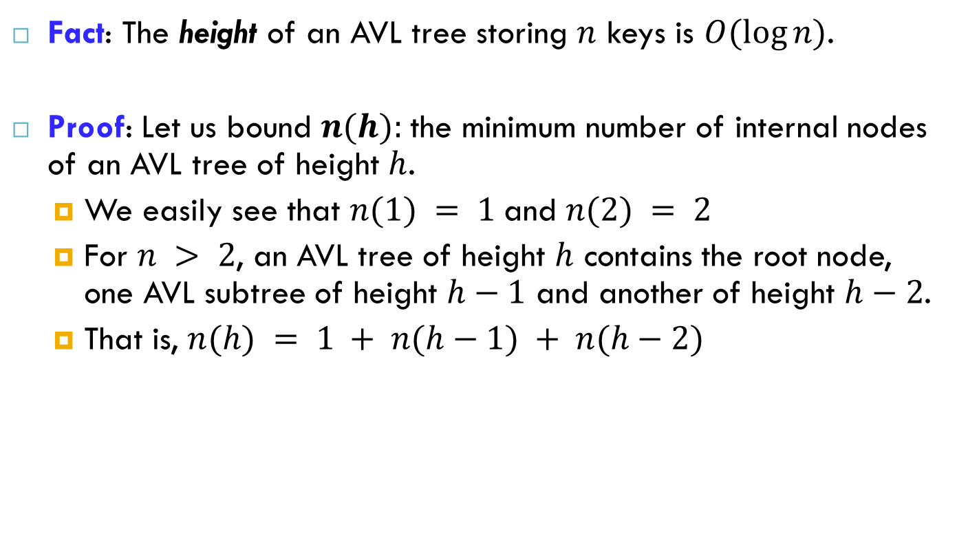
Height of an AVL Tree
n(2)
3
4
n(1)
Fact: The height of an AVL tree storing $n$ keys is $O(log⁡n)$.
Proof: Let us bound $n(h):$the minimum number of internal nodes of an AVL tree of height $h$.
We easily see that $n(1) = 1$and $n(2) = 2$
For $n > 2$, an AVL tree of height $h$ contains the root node, one AVL subtree of height $h−1$ and another of height $h−2$.
That is, $n(h) = 1 + n(h−1) + n(h−2)$

Slide 8
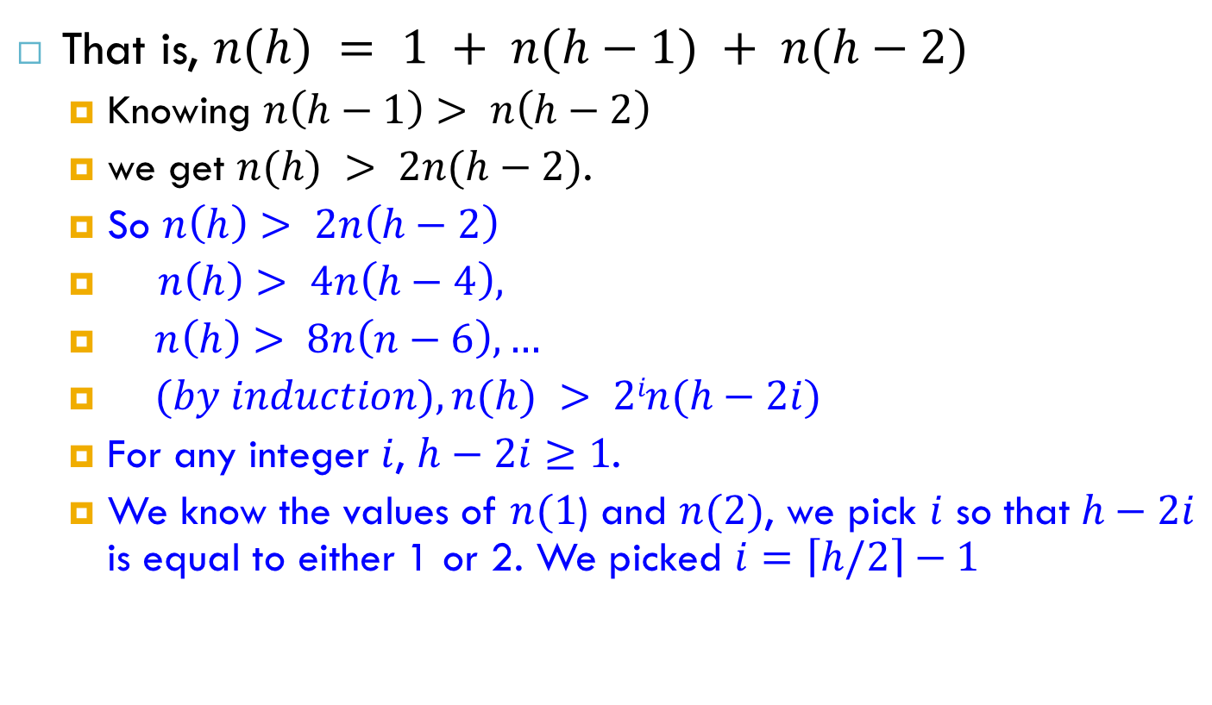
Height of an AVL Tree (cont.)
n(2)
3
4
n(1)
That is, $n(h) = 1 + n(h−1) + n(h−2)$
Knowing $n\left(h−1\right)> n\left(h−2\right)$
we get $n(h) > 2n(h−2)$.
So $n\left(h\right)> 2n\left(h−2\right)$
$n\left(h\right)> 4n\left(h−4\right),$
$n\left(h\right)> 8n\left(n−6\right), …$
$(by induction), n(h) > 2in(h−2i)$
For any integer $i$, $h−2i≥1$.
We know the values of $n(1$) and $n(2)$, we pick $i$ so that $h−2i$ is equal to either 1 or 2. We picked $i=\left\lceil h/2\right\rceil −1$

Slide 9
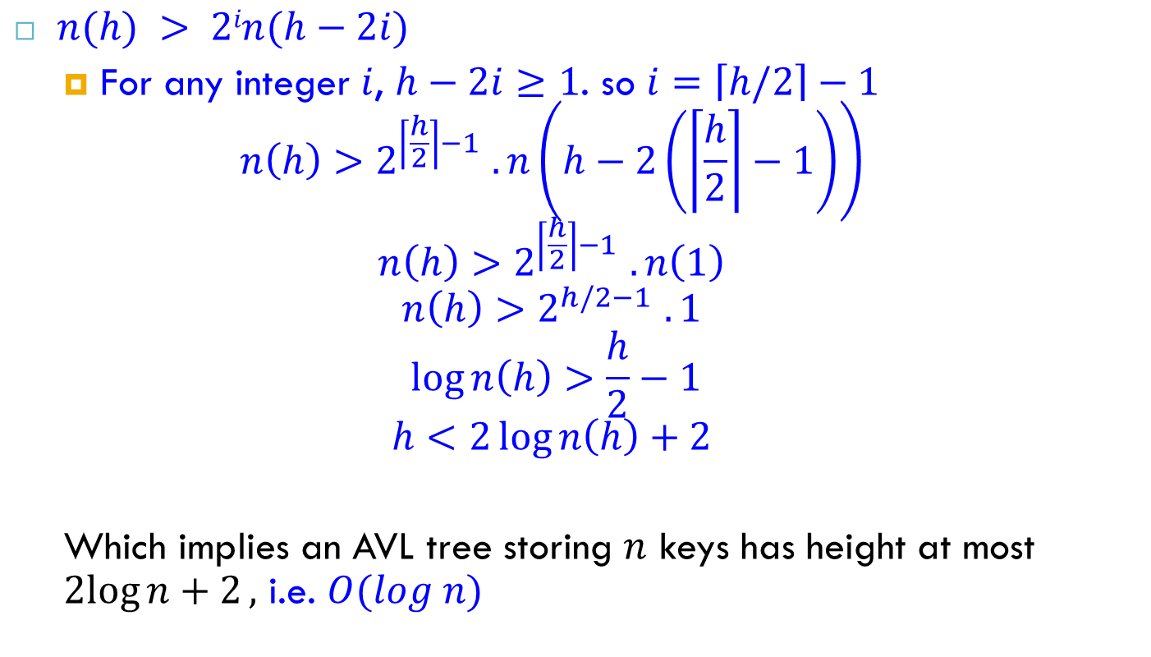
Height of an AVL Tree (cont.)
n(2)
3
4
n(1)
$n(h) > 2in(h−2i)$
For any integer $i$, $h−2i≥1$. so $i=\left\lceil h/2\right\rceil −1$
$$n\left(h\right)>2^{\left\lceil \frac{h}{2}\right\rceil −1 }.n\left(h−2\left(\left\lceil \frac{h}{2}\right\rceil −1\right)\right)$$
$$n\left(h\right)>2^{\left\lceil \frac{h}{2}\right\rceil −1 }.n\left(1\right)$$
$$n\left(h\right)>2^{h/2−1 }.1$$
$$\log{n\left(h\right)}>\frac{h}{2}−1$$
$$h<2\log{n\left(h\right)+2}$$
Which implies an AVL tree storing $n$ keys has height at most $2log{n+2},$ i.e. $O(log n)$

Slide 10
Insert and Rotation in AVL Trees
Tree A (AVL)
Tree B (AVL)
height=2 BF=1-0=1
2
6
6
1
0
1
1
3
9
3
9
0
0
0
0
0
1
5
1
5
8
height of node = h
balance factor = h_{left}-h_{right}
empty height = -1

Slide 11
Insert and Rotation in AVL Trees
Tree B (AVL)
Tree C (not AVL)
2
3
balance factor
1-(-1) = 2
6
6
1
1
1
2
3
9
3
9
0
0
0
0
0
1
-1
1
5
8
1
5
8
0
7
height of node = h
balance factor = h_{left}-h_{right}
empty height = -1

Slide 12
Insert and Rotation in AVL Trees
Insert operation may cause balance factor to become 2 or –2 for some node
only nodes on the path from insertion point to root node have possibly changed in height
So after the Insert, go back up to the root node by node, updating heights
If a new balance factor (the difference h_{left}-h_{right}) is 2 or –2, adjust tree by rotation around the node

Slide 13
Single Rotation in an AVL Tree
2
2
6
6
1
2
1
1
3
9
3
8
0
0
1
0
0
0
0
1
5
8
1
5
7
9
0
7

Slide 14
Insertions in AVL Trees
Let the node that needs rebalancing be α.
There are 4 cases:
Outside Cases (require single rotation) :
Insertion into left subtree of left child of α.
Insertion into right subtree of right child of α.
Inside Cases (require double rotation) :
Insertion into right subtree of left child of α
Insertion into left subtree of right child of α.
The rebalancing is performed through four separate rotation algorithms.

Slide 15
AVL Insertion: Outside Case
j
Consider a valid
AVL subtree
k
h
Z
h
h
X
Y

Slide 16
AVL Insertion: Outside Case
Inserting into X
destroys the AVL
property at node j
j
k
h
Z
h+1
h
Y
X

Slide 17
AVL Insertion: Outside Case
j
Inserting into X destroys the AVL property at node j
Do a “right rotation”
k
h
Z
h+1
h
Y
X

Slide 18
Single right rotation
j
Do a “right rotation”
k
h
Z
h+1
h
Y
X

Slide 19
Outside Case Completed
“Right rotation” done!
(“Left rotation” is mirror symmetric)
k
j
h+1
h
h
X
Y
Z
AVL property has been restored!

Slide 20
AVL Insertion: Inside Case
Consider a valid AVL subtree
j
k
h
Z
h
h
X
Y

Slide 21
AVL Insertion: Inside Case
Inserting into Y destroys the AVL property at node j
j
Does “right rotation”
restore balance?
k
h
Z
h
h+1
X
Y

Slide 22

AVL Insertion: Inside Case
“Right rotation” does not restore balance…
now $k$ is out of balance
k
j
h
X
h
h+1
Z
Y

Slide 23
AVL Insertion: Inside Case
Consider the structure
of subtree Y…
j
k
h
Z
h
h+1
X
Y

Slide 24
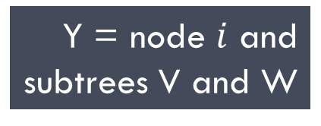
AVL Insertion: Inside Case
Y = node $i$ and
subtrees V and W
j
k
h
Z
i
h
h+1
X
h or h-1
V
W

Slide 25
AVL Insertion: Inside Case
j
We will do a left-right
“double rotation” . . .
k
Z
i
X
V
W

Slide 26
Double rotation : first rotation
j
left rotation complete
i
Z
k
W
V
X

Slide 27
Double rotation : second rotation
j
Now do a right rotation
i
Z
k
W
V
X

Slide 28
Double rotation : second rotation
right rotation complete
Balance has been restored
i
k
j
h
h
h or h-1
V
X
W
Z

Slide 29
Implementation
balance (1,0,-1)
key
left
right
No need to keep the height; just the difference in height, i.e. the balance factor; this has to be modified on the path of insertion even if you don’t perform rotations
Once you have performed a rotation (single or double) you won’t need to go back up the tree

Slide 30
Insertion in an AVL Tree
Insertion is as in a binary search tree
Always done by expanding an external node.
Example: Insert 54
44
44
17
78
c=z
17
78
a=y
32
50
88
32
50
88
48
62
48
62
b=x
54
w
before insertion
after insertion

Slide 31
Tri-node Restructuring
let (a,b,c) be an inorder listing of x, y, z
perform the rotations needed to make b the topmost node of the three
(other two cases are symmetrical)
case 2: double rotation
(a right rotation about c, then a left rotation about a)
a=z
a=z
T₀
c=y
T₀
b=y
c=x
b=x
T₃
T₁
b=y
T₁
T₂
b=x
T₂
T₃
a=z
c=x
a=z
c=y
case 1: single rotation
(a left rotation about a)
T₀
T₁
T₂
T₃
T₀
T₁
T₂
T₃

Slide 32
Insertion Example, continued
unbalanced...
T
4
1
44
2
3
x
17
y
62
z
1
2
2
32
50
78
1
1
1
...balanced
48
54
88
T
2
T
T
T
0
1
3

Slide 33
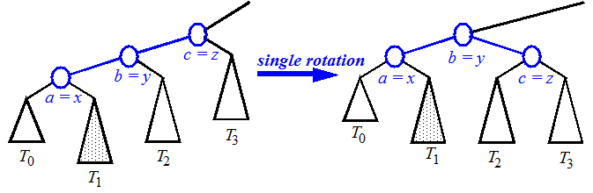
Restructuring (as Single Rotations)
Single Rotations:

Slide 34
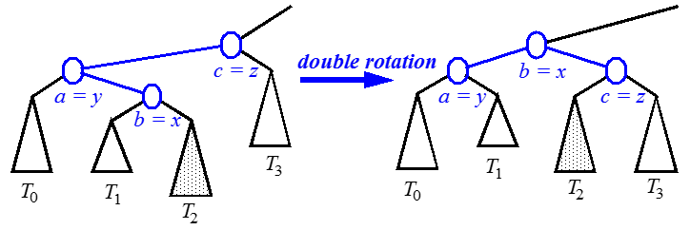
Restructuring (as Double Rotations)
double rotations:

Slide 35
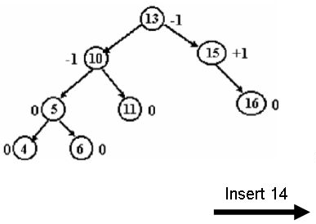
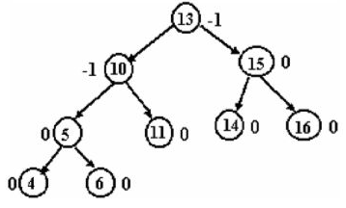
Insertion in an AVL Tree
Example source: Web

Slide 36
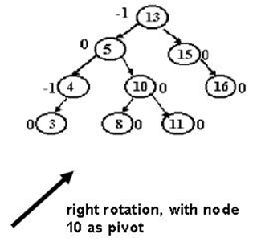
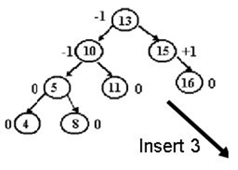
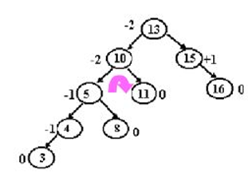
Insertion in an AVL Tree
Example source: Web

Slide 37
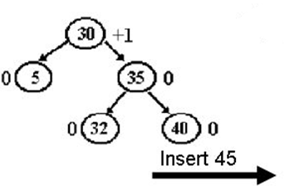
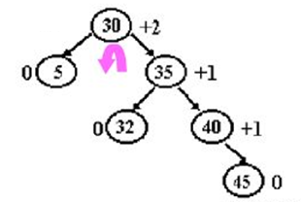

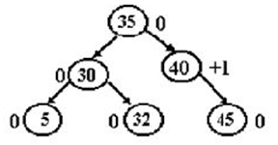
Insertion in an AVL Tree
Example source: Web

Slide 38
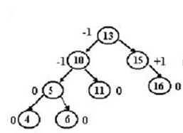
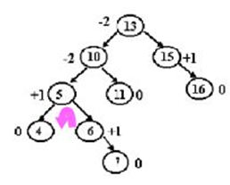


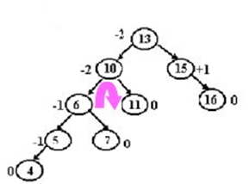
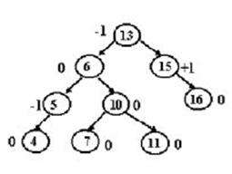

Insertion in an AVL Tree
Example source: Web

Slide 39
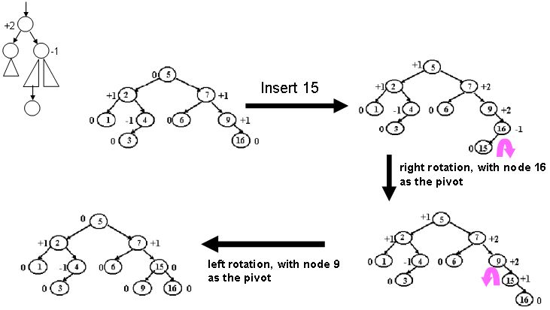
Insertion in an AVL Tree
Example source: Web

Slide 40
Removal in an AVL Tree
Removal begins as in a binary search tree, which means the node removed will become an empty external node. Its parent, w, may cause an imbalance.
Example:
44
44
17
62
17
62
50
78
32
50
78
48
54
88
48
54
88
before deletion of 32
after deletion

Slide 41
Rebalancing after a Removal
Let z be the first unbalanced node encountered while travelling up the tree from w. Also, let y be the child of z with the larger height, and let x be the child of y with the larger height.
What if, both children of y have the same height?
We perform restructure(x) to restore balance at z.
As this restructuring may upset the balance of another node higher in the tree, we must continue checking for balance until the root of T is reached
62
a=z
44
44
78
w
17
62
b=y
17
50
88
50
78
c=x
48
54
48
54
88

Slide 42
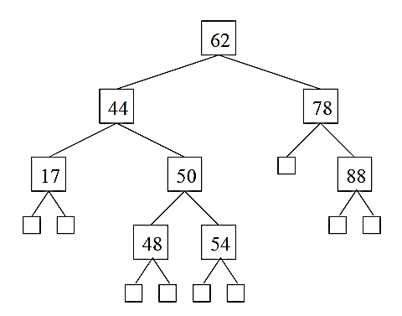
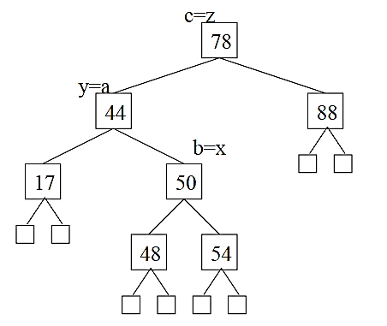
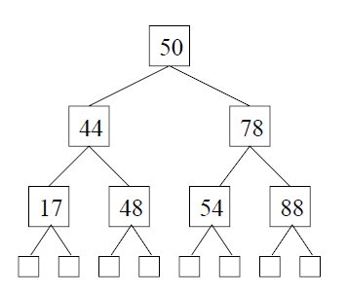
Delete 62
Source: online

Slide 43
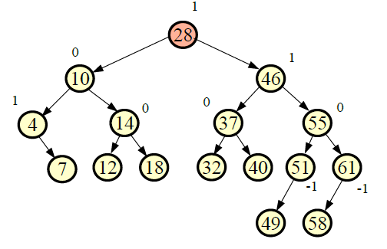
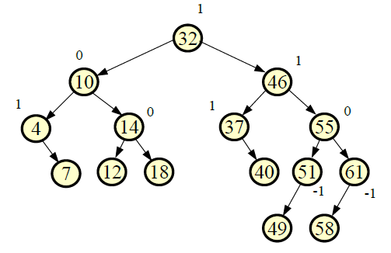
AVL Tree – Delete 28
Source: online

Slide 44
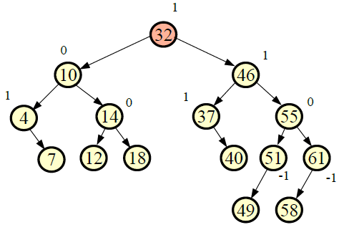
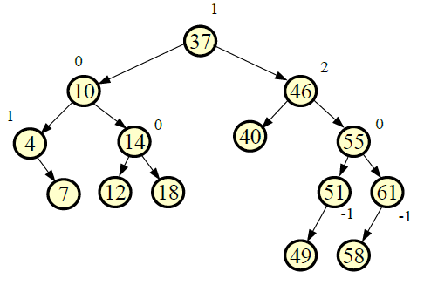
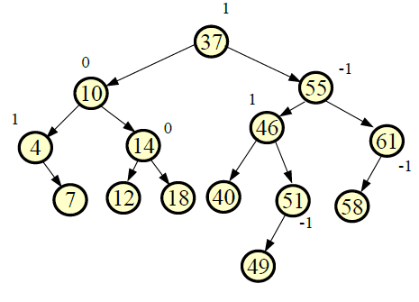
AVL Tree – Delete 32
Source: online
Notes:
Source: Internet

Slide 45
Running Times for AVL Trees
a single restructure is O(1)
using a linked-structure binary tree
find is O(log n)
height of tree is O(log n), no restructures needed
insert is O(log n)
initial find is O(log n)
Restructuring up the tree, maintaining heights is O(log n)
remove is O(log n)
initial find is O(log n)
Restructuring up the tree, maintaining heights is O(log n)

Slide 46
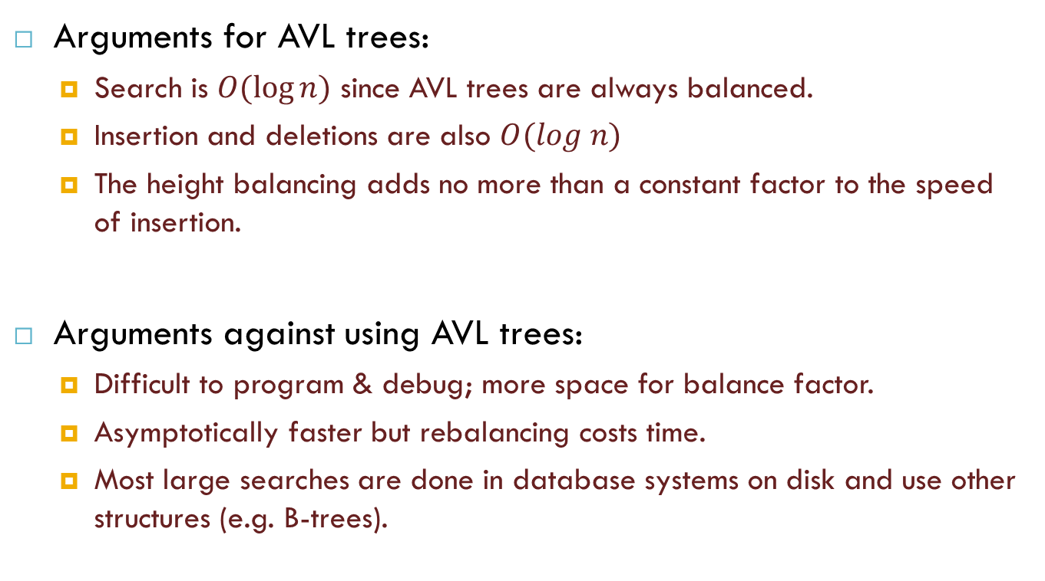
Pros and Cons of AVL Trees
Arguments for AVL trees:
Search is $O(log⁡n)$ since AVL trees are always balanced.
Insertion and deletions are also $O(log n)$
The height balancing adds no more than a constant factor to the speed of insertion.
Arguments against using AVL trees:
Difficult to program & debug; more space for balance factor.
Asymptotically faster but rebalancing costs time.
Most large searches are done in database systems on disk and use other structures (e.g. B-trees).

Slide 47
Reference
Algorithm Design: Foundations, Analysis, and Internet Examples. Michael T. Goodrich and Roberto Tamassia. John Wiley & Sons.
Introduction to Algorithms. Thomas H. Cormen, Charles E. Leiserson, Ronald L. Rivest, Clifford Stein.
Few pictures/slides are taken from online only for learning purpose. Credit goes to them as well.

Slide 48
Thank you!

